Slide 1
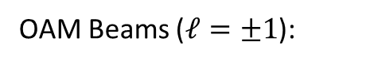
OAM Beams ($ℓ=±1$):

Slide 2
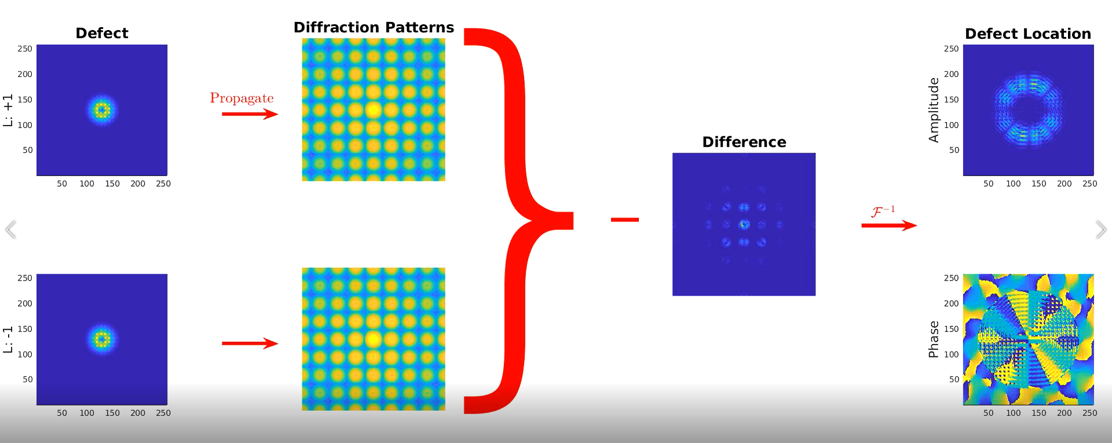
Simulation workflow:

Slide 3
Point defect on a flat substrate:

Slide 4
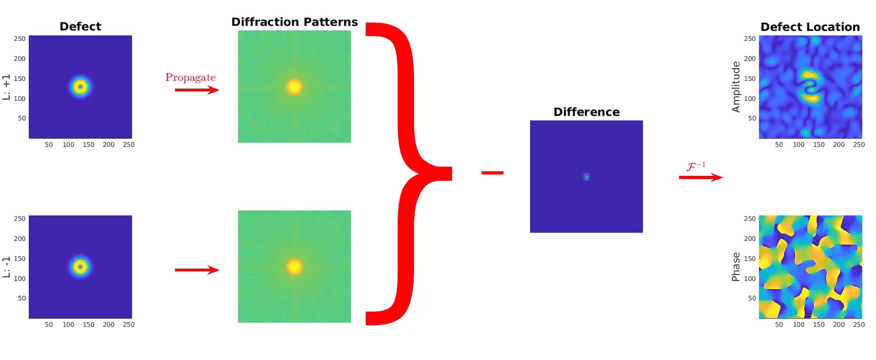
OAM Beams ($ℓ=±1$):

Slide 5
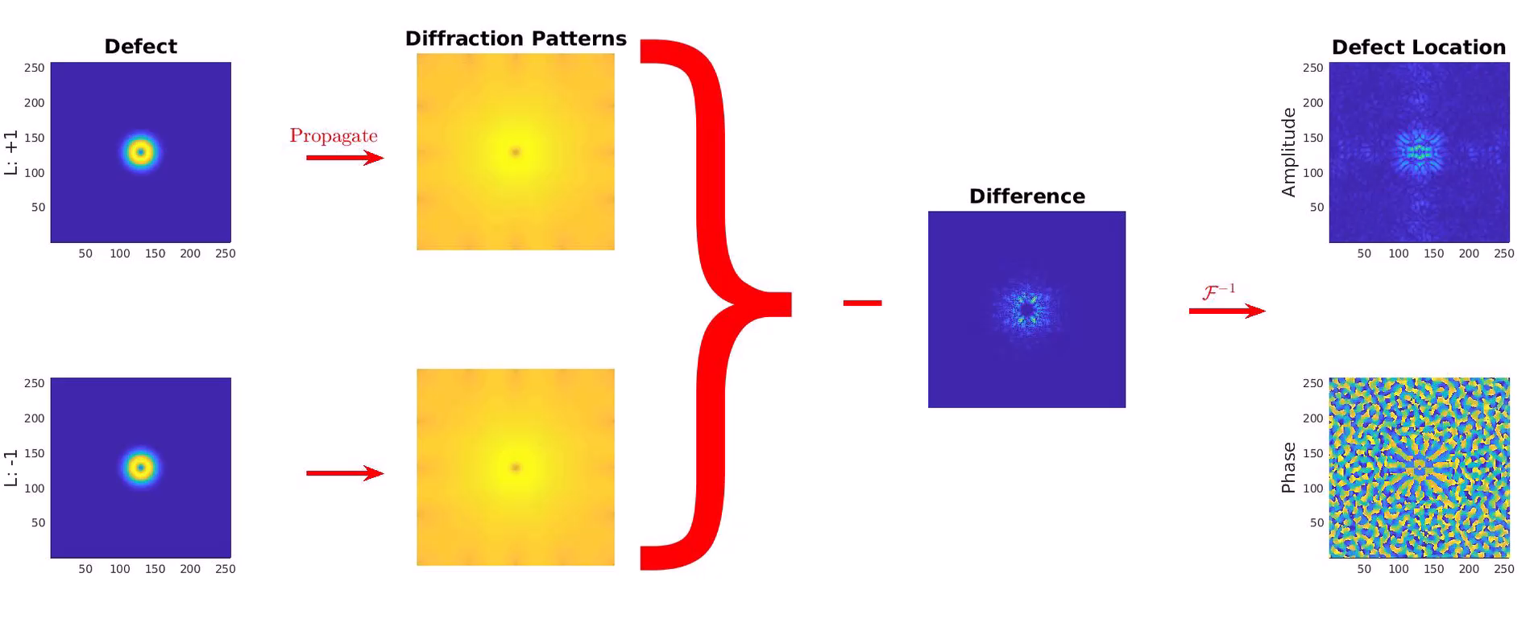
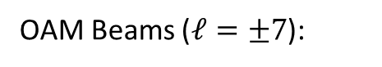
OAM Beams ($ℓ=±7$):

Slide 6
Point defect on a 1D grating:

Slide 7
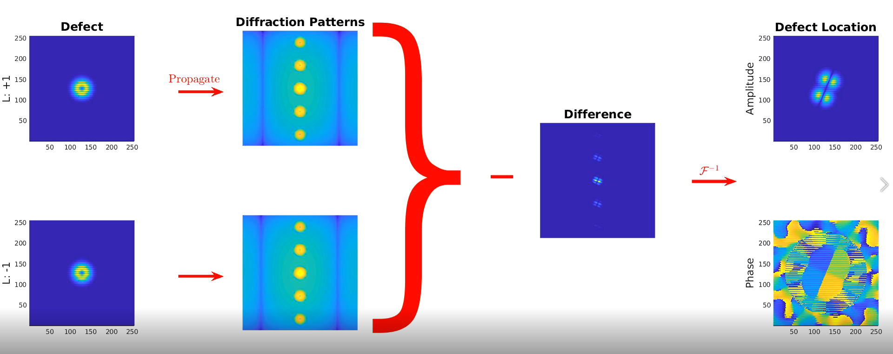
OAM Beams ($ℓ=±1$):

Slide 8
Point defect in between two 1D gratings:

Slide 9
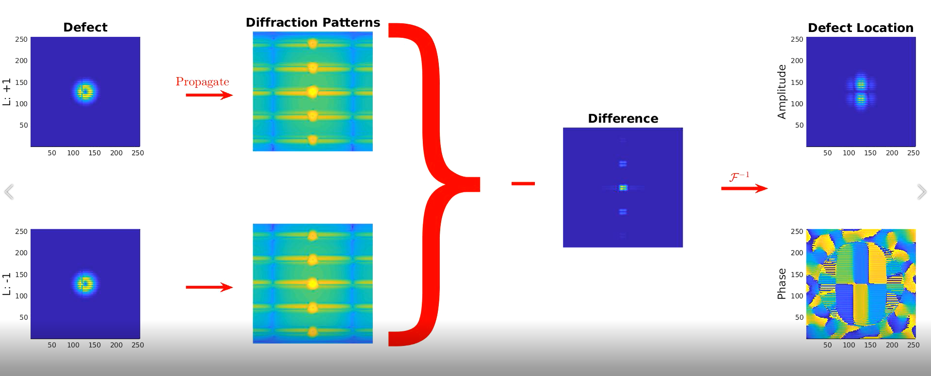
OAM Beams ($ℓ=±1$):

Slide 10
Point defect on a 2D grating:

Slide 11
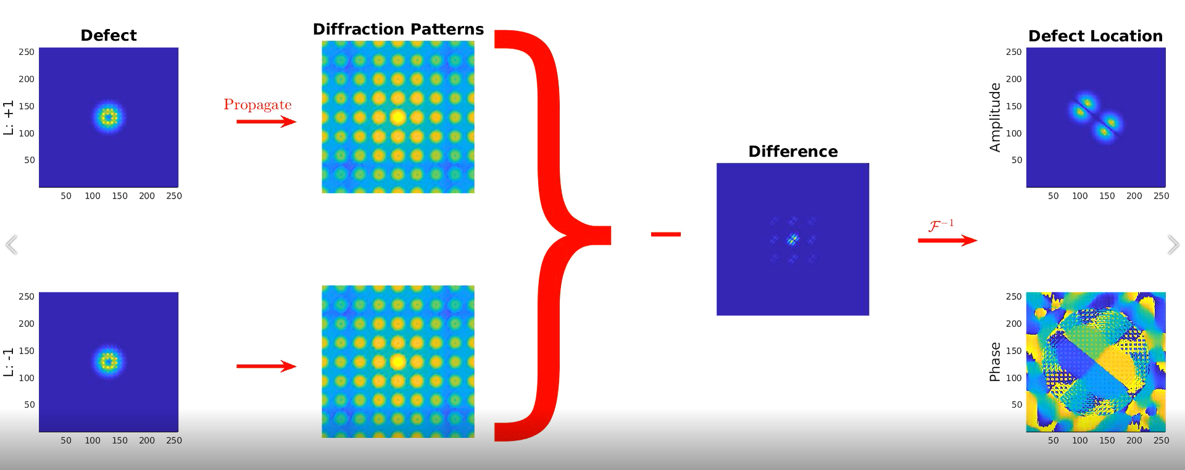
OAM Beams ($ℓ=±1$):

Slide 13
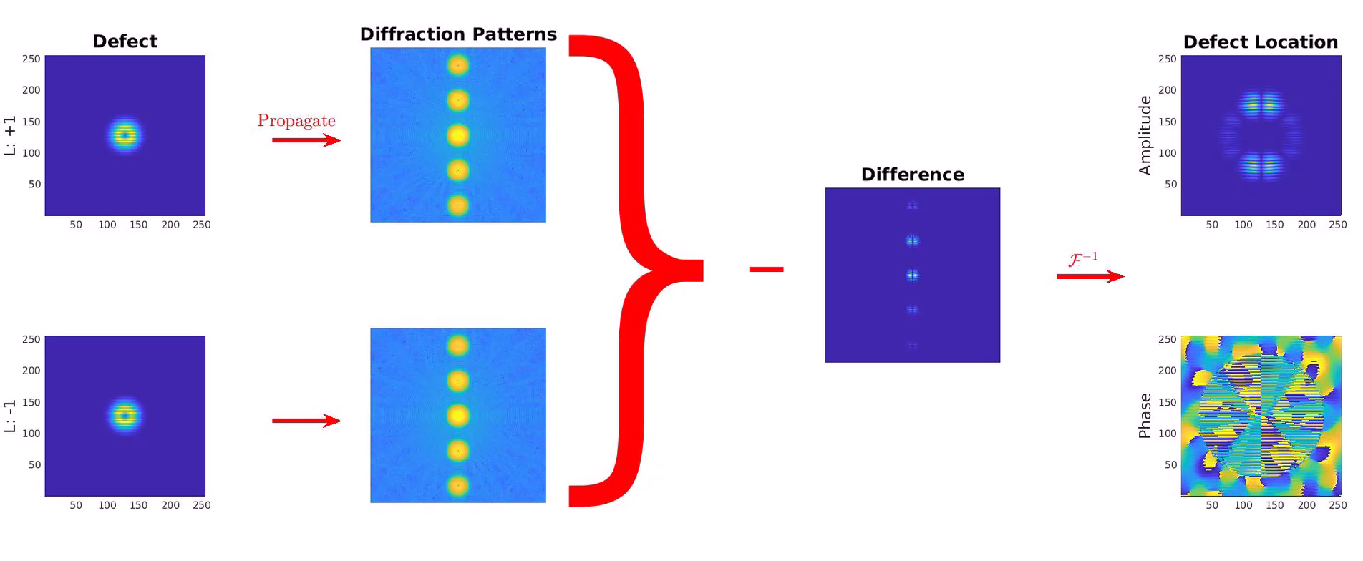
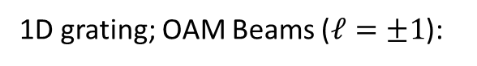
1D grating; OAM Beams ($ℓ=±1$):

Slide 14
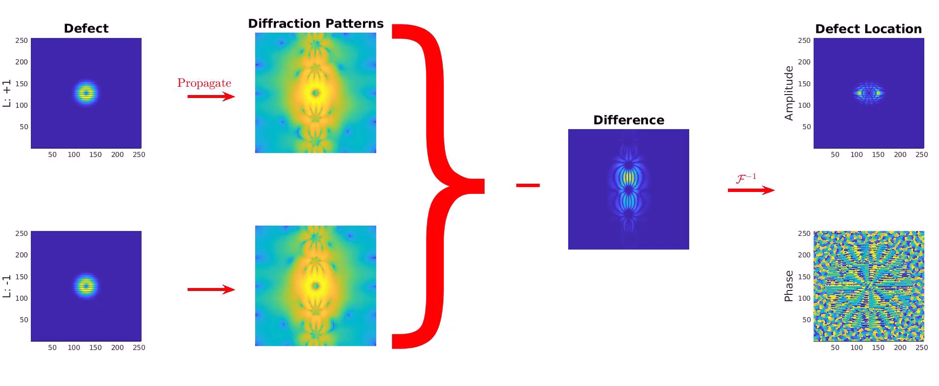
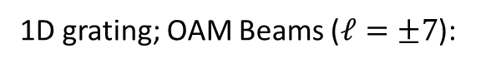
1D grating; OAM Beams ($ℓ=±7$):

Slide 15

Two 1D gratings with a gap; OAM Beams ($ℓ=±1$):

Slide 16

Two 1D gratings with a gap; OAM Beams ($ℓ=±7$):

Slide 17

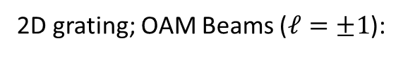
2D grating; OAM Beams ($ℓ=±1$):

Slide 18

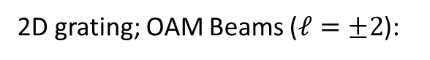
2D grating; OAM Beams ($ℓ=±2$):

Slide 19
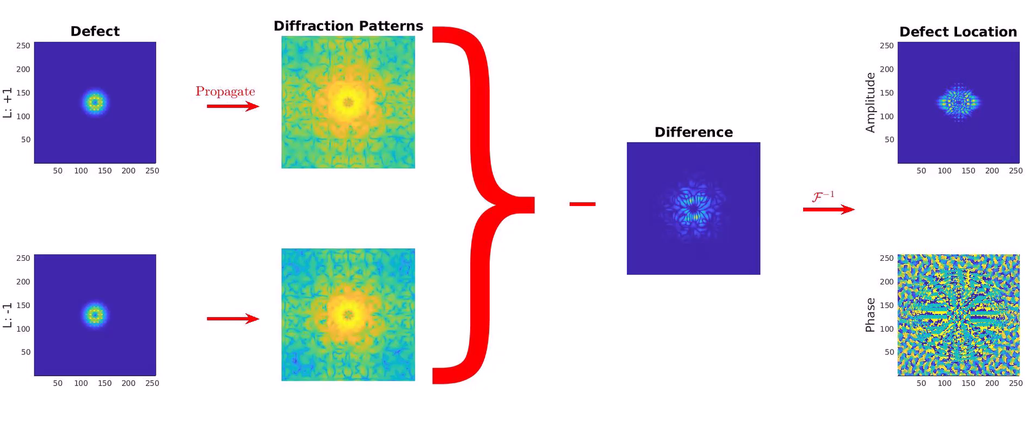
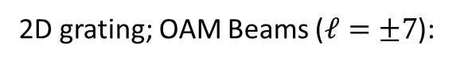
2D grating; OAM Beams ($ℓ=±7$):

Slide 20
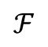
Simulation workflow:
OAM beam +1
Object
$$ℱ$$
OAM beam -1

Slide 21
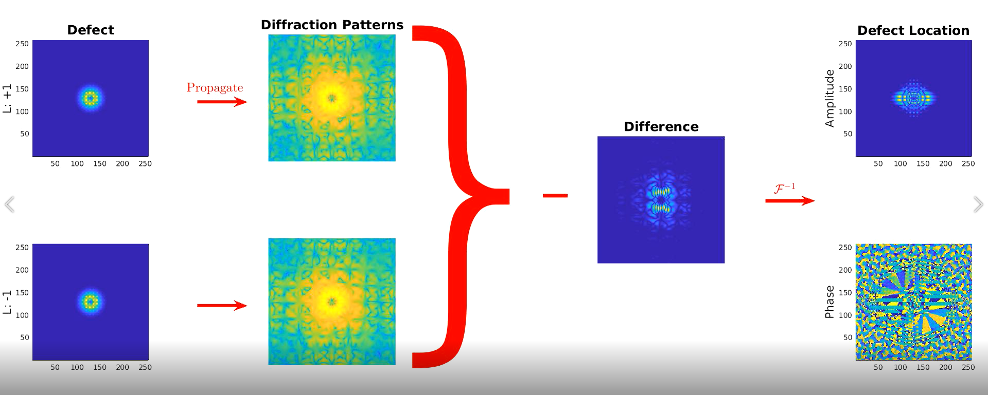
OAM Beams ($ℓ=±7$):

Slide 22
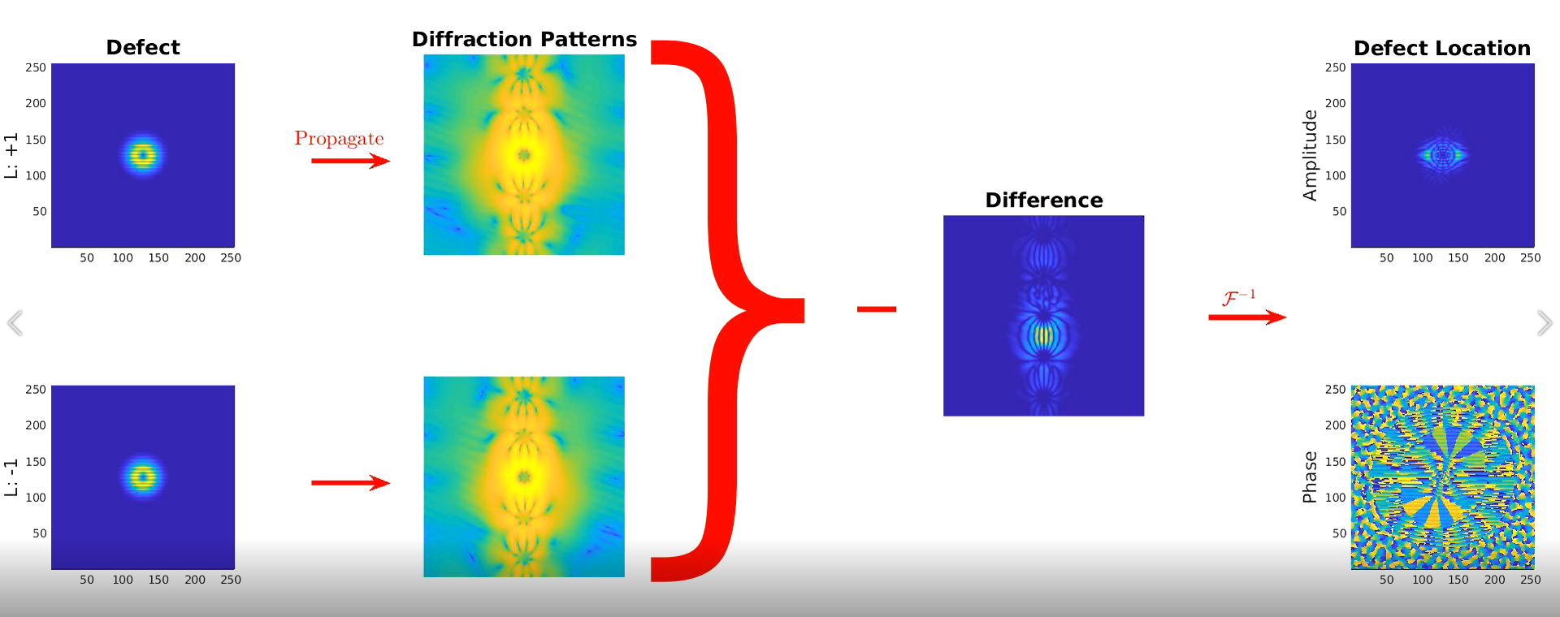
OAM Beams ($ℓ=±7$):

Slide 23
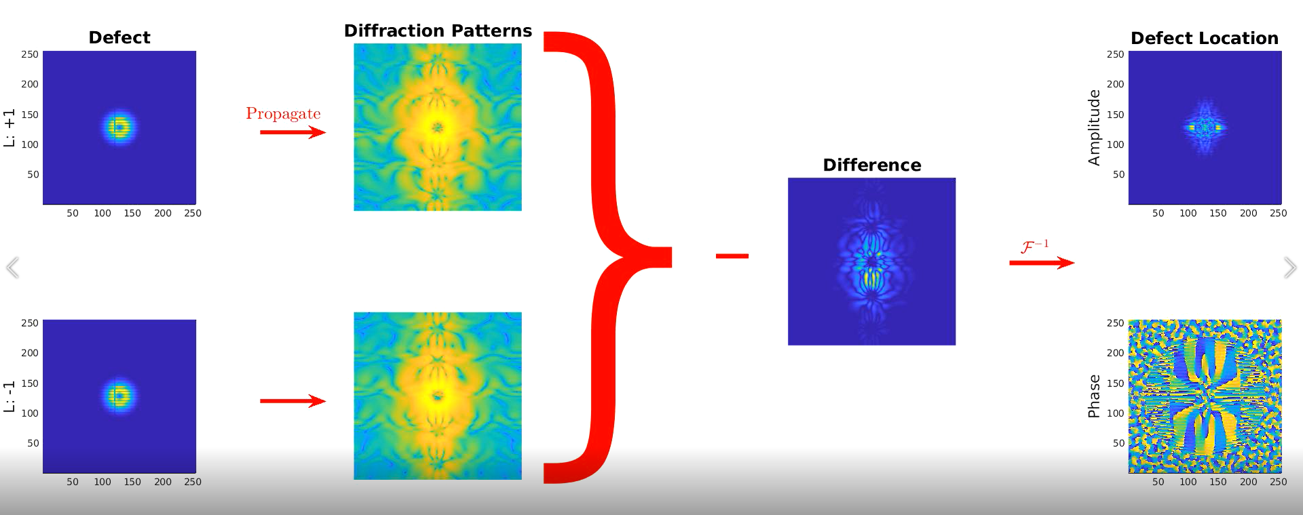
OAM Beams ($ℓ=±7$):

